Slide 1
GROUP 5
ANOKYE Jeffrey Enyan Peprah (1844622)
CIICI Aggrey-Fynn (7311423)
AIDOO Kweku Adu-Gyamfi Nhyira (7312123)
ADDEI Albert Yaw (7309823)
ADOMBILIA Judah Ramtin (7310423)
ADU-ACHEAMPONG Emmanuel (7310623)
AGBESI Tracy Elorm (7311323)
OHENEBA Boakye Ansah (1858922)
ASHILEY Samuel Tetteh (3549718)

Slide 2
SWIMMING POOL WATER MONITORING SYSTEM

Slide 3
TABLE OF CONTENT
PROBLEM STATEMENT
METHOLOGY
SENSORS
SIGNAL PROCESSING
CHALLENGES FACED
CONCLUSIONS

Slide 4
Problem Statement
Maintaining Water Quality
Making sure safe and hygienic pool water is essential to protect users from infections, irritation and harmful contaminants
Increased Turbidity
Cloudy or unclear water is mostly used as signals for presence of microorganisms or pollutants.
pH level imbalance
When pH of the water is too acidic or too alkaline, it causes discomfort to the users of the pool water and it affects the effectiveness of the disinfectants
Need for Automated Monitoring
There is the need for the system to continuously track the quality of water and alert lifeguards when the water becomes unsafe for the users
Temperature Variations
Higher or lower temperature water creates favorable conditions for bacterial growth which increases the risk of contamination

Slide 5

Objective
Develop a system that monitors pool water quality and alerts users when conditions are unsafe

Slide 6
METHOLODOLOGY

Slide 7
METHODOLOGY
Sensor setup
Used a photoresistor as a sensor to detect light intensity as a turbidity sensor, two potentiometers to simulate a temperature sensor and pH sensor to measure acidity and alkalinity
Data Acquisition
Continuous raw readings from all sensors were collected through the microcontroller, ensuring real time monitoring of environmental parameters
Real Time Display
Displayed real-time readings on an LCD screen
Safety Alerts
Triggered a buzzer and LED indicators if values exceeded safe limits

Slide 8
SENSORS

Slide 9
Potentiometer as pH Sensor
The potentiometer serves as a pH sensor, where its resistance changes correspond to varying pH levels from 0 to 14. The calculation used is (14/1023) multiplied by the value read from the analog pin. This conversion allows for the determination of the pH level based on the voltage output from the potentiometer.

Slide 10
Photo Resistor for Turbidity
The Photoresistor operates as the turbidity sensor for this setup. It detects how much light is penetrating the water sample. When the water is clear, more light reaches the photoresistor causing its resistance to drop and produce a higher voltage output. When the water is not clear, suspended particles block the light thereby increasing the resistance of the photoresistor

Slide 11
Potentiometer as Temperature Sensor
The potentiometer was used as a substitute for the temperature sensor, since we had no temperature sensor. By increasing or reducing the resistance, the potentiometer simulates changes in temperature.
Analog value read from the microcontroller varies from 0 to 1023, and this range is mapped to a chose temperature scale. This allows the system to interpret the potentiometer’s voltage as corresponding temperature values for testing and demonstration purposes

Slide 12
LINK TO THE SIMULATION OF OUR PROJECT
https://www.tinkercad.com/things/1cXPH8iz52n-swimming-monitoring-detector/editel?sharecode=EAfhrvFc9LAcJuevsPrvHvxx3g6Wux5bGuvm6PhByKo

Slide 13
SIGNAL PROCESSING

Slide 14
Voltage and Resistance Conversion
For both the photo resistor and potentiometer, analog readings are converted into a voltage range suitable for the microcontroller. The photo resistor converts light levels into a voltage output ranging from 0 to 5V, which is then scaled to a digital value between 0 and 1023 for processing. This enables accurate monitoring of light levels that relate to turbidity.

Slide 15
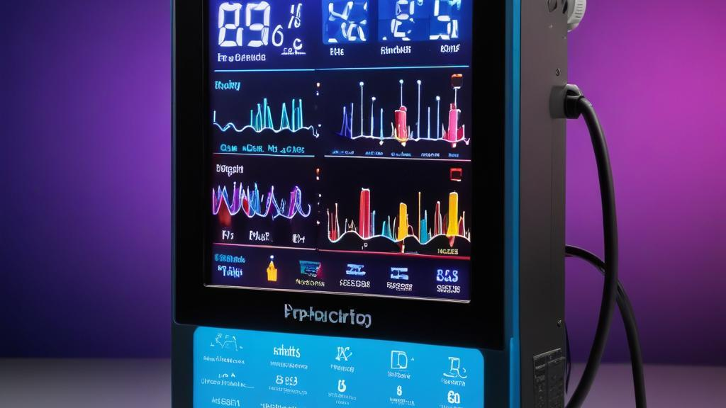
LCD Display Outputs
The LCD 16×2(I2C) displays the interpreted sensor outputs, showing pH levels, turbidity, and temperature readings. This provides real-time feedback on system performance and ensures users can easily access and visualize the data being collected by the sensors. Each sensor's output is updated to reflect current measurements, enhancing the interactivity of the simulation.

Slide 16
Buzzer Activation Conditions
The buzzer serves as an alarm mechanism, activating whenever temperature falls below 19°C or rises above 30°C, when pH levels drop below 7.2 or exceed 7.8, or when turbidity surpasses 40%. These thresholds ensure that any unsafe change in water conditions is immediately detected, allowing timely corrective action.

Slide 17
CHALLENGES AND CONCLUSIONS

Slide 18
CHALLENGES FACED
We made use of Tinkercad for our simulation, and unfortunately we could not find a turbidity sensor, a temperature sensor, or a pH sensor within the platform.
HOW WE SOLVED THE PROBLEMS
Because we had no turbidity sensor, we opted for a photoresistor
Because we had no temperature sensor and pH detector, we opted for a potentiometer

Slide 19
Conclusions
The simulation effectively integrates various sensors, capturing environmental data such as temperature, pH, and turbidity. By employing signal processing techniques and displaying results on the LCD, the simulation demonstrates a comprehensive understanding of real-world applications of sensor technology.

